Slide 1



Developing an
Invasive Plant Management Plan
for Your Organization

Slide 2
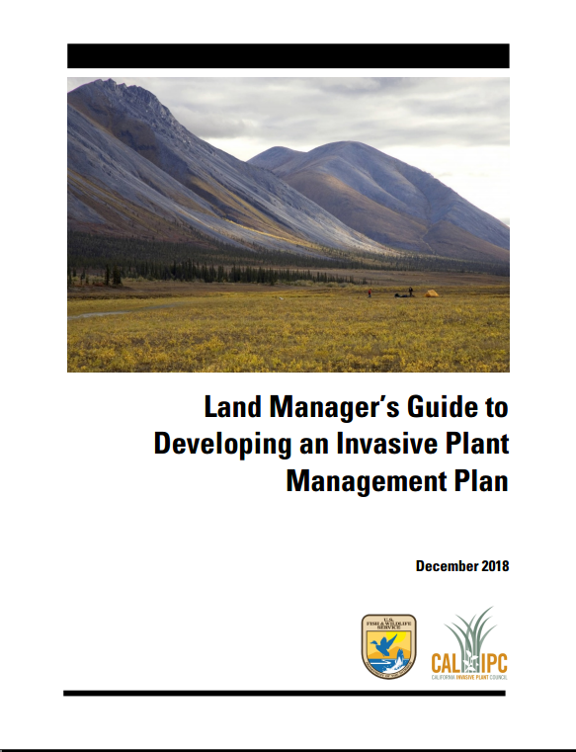
Notes:
JUTTA. Welcome
This training is funded by a grant from the Western Center for Integrated Pest Management to support adoption of integrated pest management practices.
Developed from a guide that was recently published by USFWS and Cal-IPC.
Goals: Walk you through the Guide and to provide you with a basic how-to for how to develop and implement a sound invasive plant management plan with real-world examples.
Introductions.

Slide 3
Why plan?
Lack of:
understanding about invasive plants
prevention and EDRR
inventory and monitoring
integrative approach
SMART objectives and adaptation
proactive action
staff continuity
Guide Section 1.3, p.5-7: Doug Johnson
Notes:
DOUG - interactive with examples/testimonials. Include brief explanation of prevention, containment, eradication, suppression.

Slide 4

strategic… (i.e. thinking it through well)
adaptive… (i.e. evaluating and adjusting)
Integrated Pest Management!
Guide Section 1.3, p.5-7: Doug Johnson
Notes:
DOUG

Slide 5
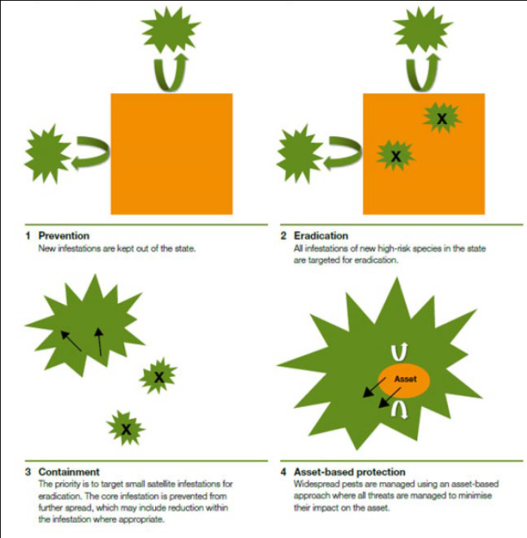
Define your management terms
1. Prevention
2. Eradication*
3. Containment
4. Asset-based protection
including:
- detection surveys
- surveillance
Guide Section 1.3, p.7: Doug Johnson
Notes:
Doug

Slide 6
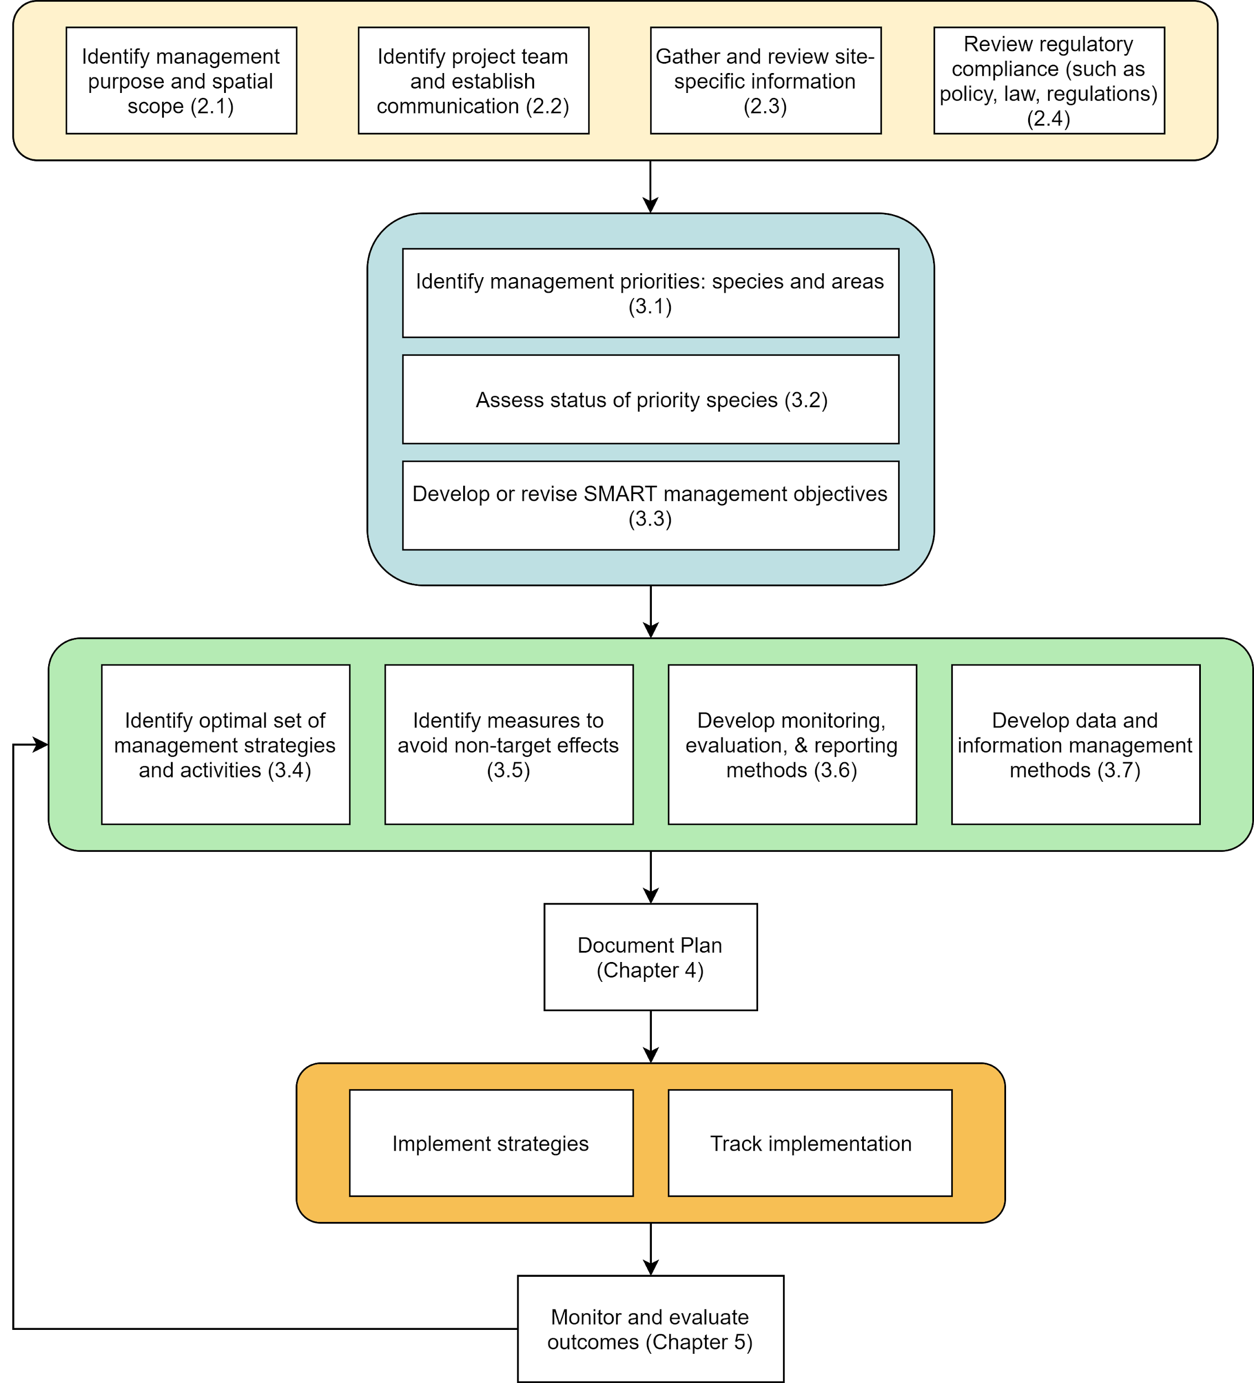
Guide: Figure 1, p.2 and Table 1, p.3
Notes:
GISELLE 1

Slide 7

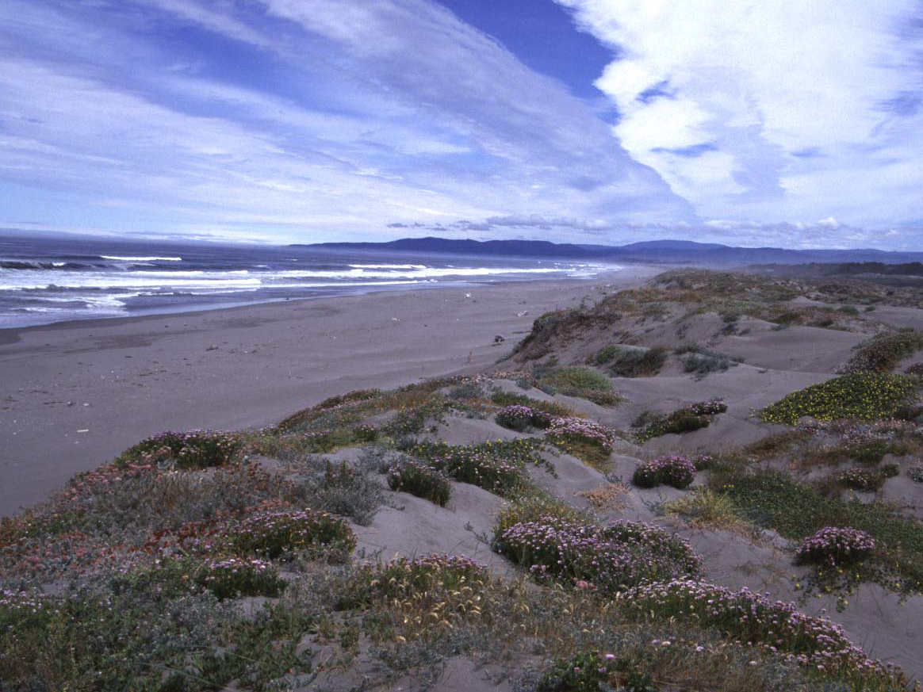
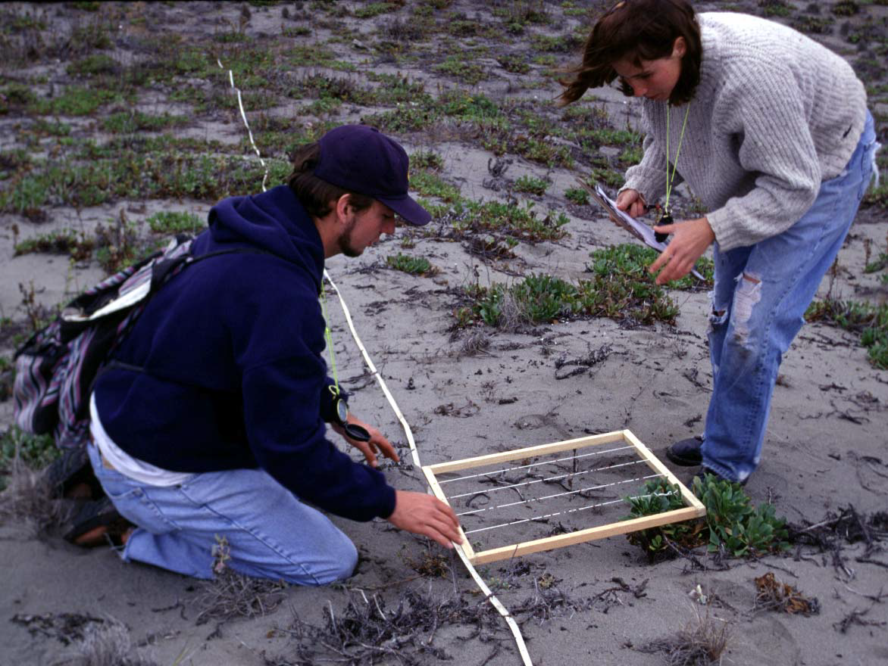
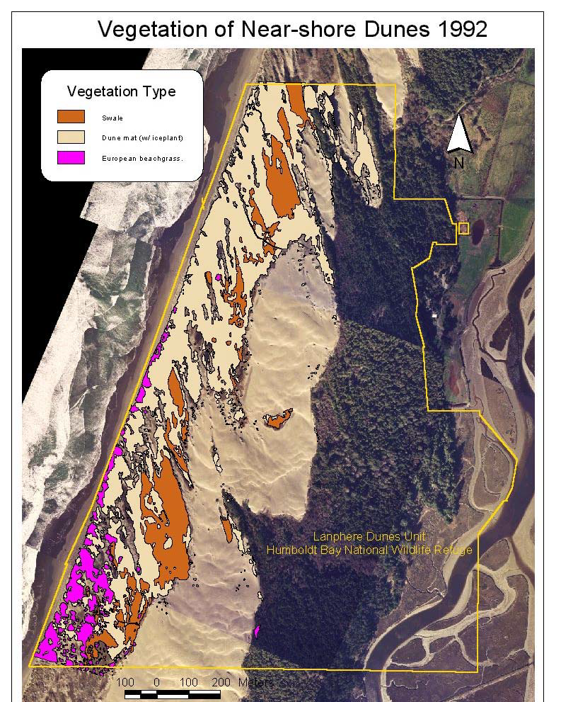
Humboldt Bay
Coastal Sand Dune Ecosystem
Conservation focus: coastal sand dune ecosystem
Priority invasive species: European beachgrass, iceplant
Baseline assessment
Objective: maintenance levels (<1%)
Integrated set of strategies:
approach: prevention, containment, suppression
techniques: manual, burning, herbicides, active/passive restoration
Monitoring: % cover invasive and native species
Learning/adaptation: funding decline, shifts in public opinion>change techniques
Notes:
GISELLE 2
Eradication not possible. what does eradication mean?

Slide 8
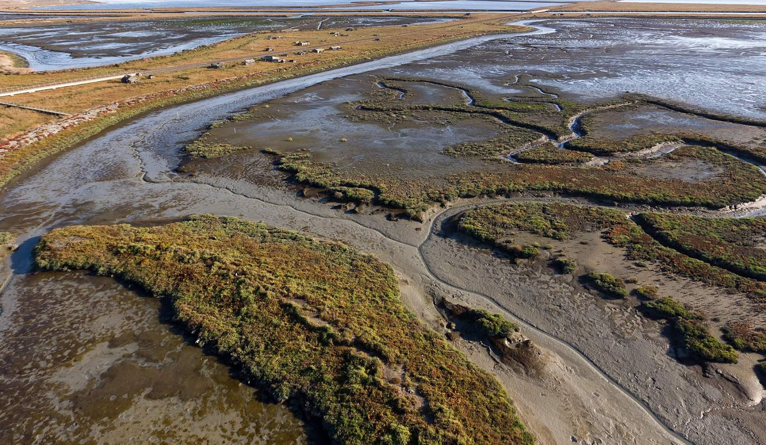
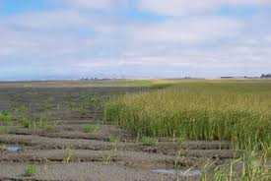
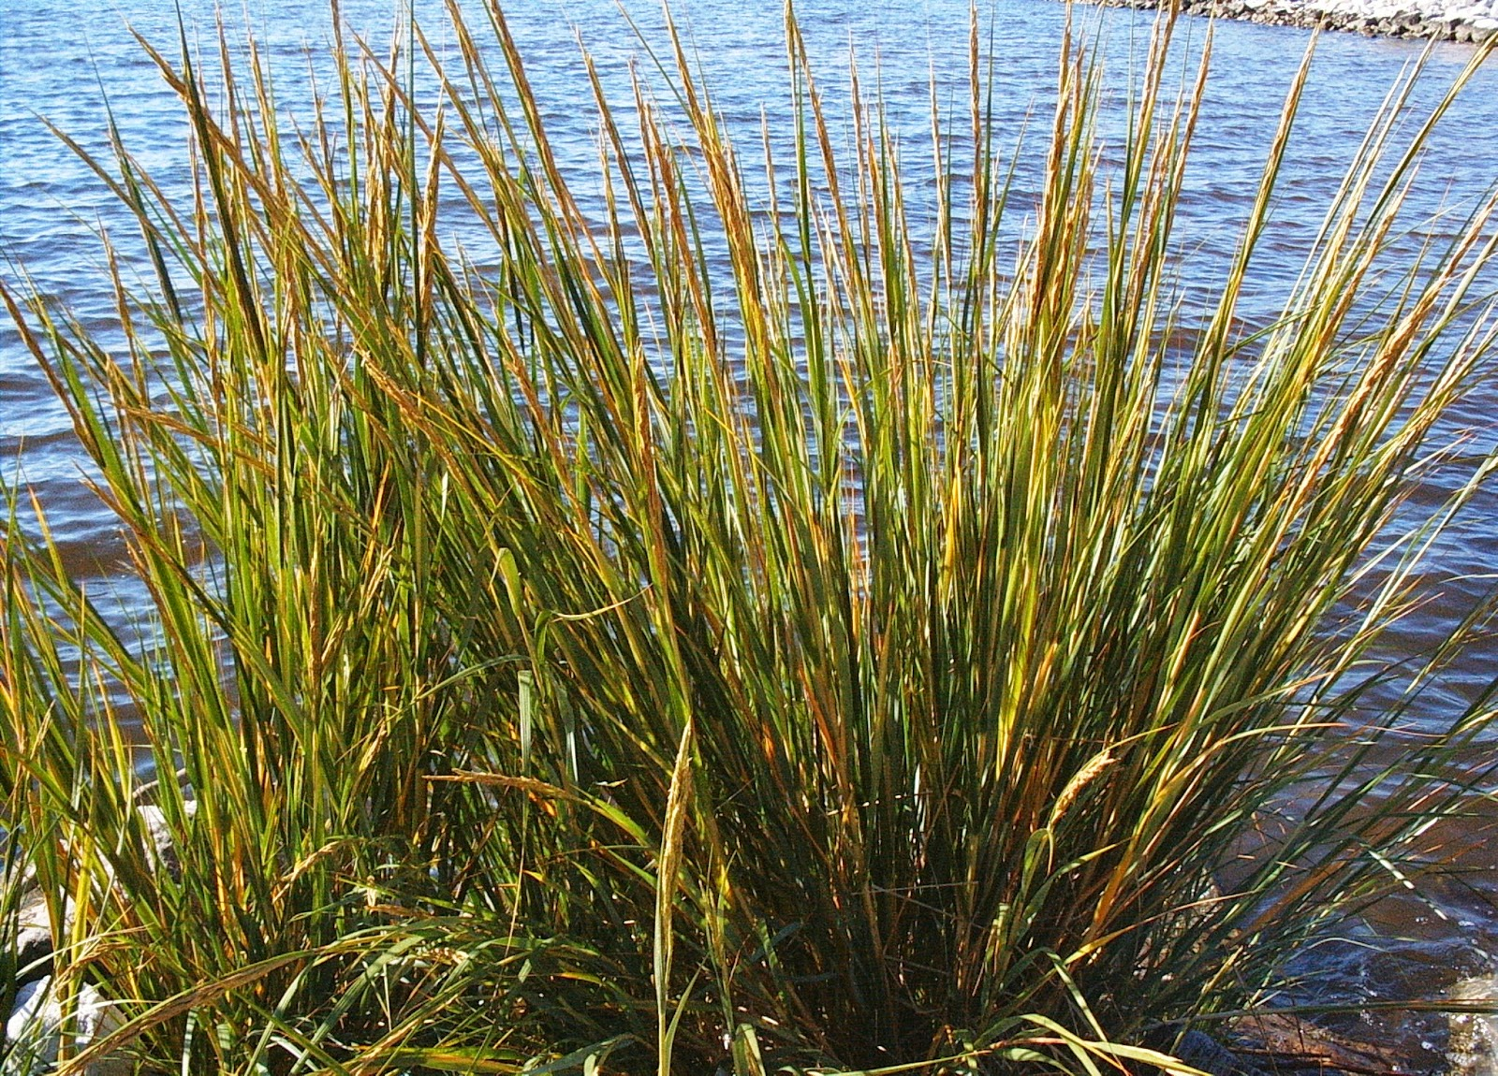
San Francisco Estuary
Invasive Spartina Project
Scope: San Francisco Estuary
Conservation focus: tidal marsh ecosystem
Priority invasive species: Invasive Spartina species and hybrids
Baseline: field-based mapping, genetic sampling
Objective: eradication
Integrated set of strategies:
approach: prevention, eradication
techniques: eradication-manual, herbicides, restoration
Monitoring: Spartina distribution and abundance, native plant response, wildlife response
Learning/adaptation: unacceptable levels of non-target-effects>increased restoration efforts, treatment phasing
Notes:
GISELLE 2

Slide 9
Terminology
Invasive species are non-native organisms whose introduction causes or is likely to cause economic or environmental harm or harm to human, animal, or plant health (Executive Order No. 13751, 2016)
Other terms: nuisance species, pest, weed, alien, non-native…...
Guide Section 1.2, p.4
Notes:
GISELLE 4

Slide 10
Guide: Figure 1, p.2 and Table 1, p.3
Notes:
BRENT

Slide 11

Preparing to Write a Plan
Identify Purpose & Scope
Identify Team
Gather site-specific information
Review Compliance
Guide Section 2.1, p.9
Notes:
Brent 2

Slide 12
Identify Purpose
Purpose: The Plan should present a compelling case for why invasive plant management is needed and how it is impeding your ability to achieve your organization’s mission and conservation goals.
Notes:
Brent 3 - include dividing into management areas

Slide 13
Identify Scope
Scope of Activities: What does the plan cover? What doesn’t it cover?
Spatial: Establish geographic area where activities will occur.
Thematic: May cover a certain type of community or system.
Notes:
Brent 4

Slide 14
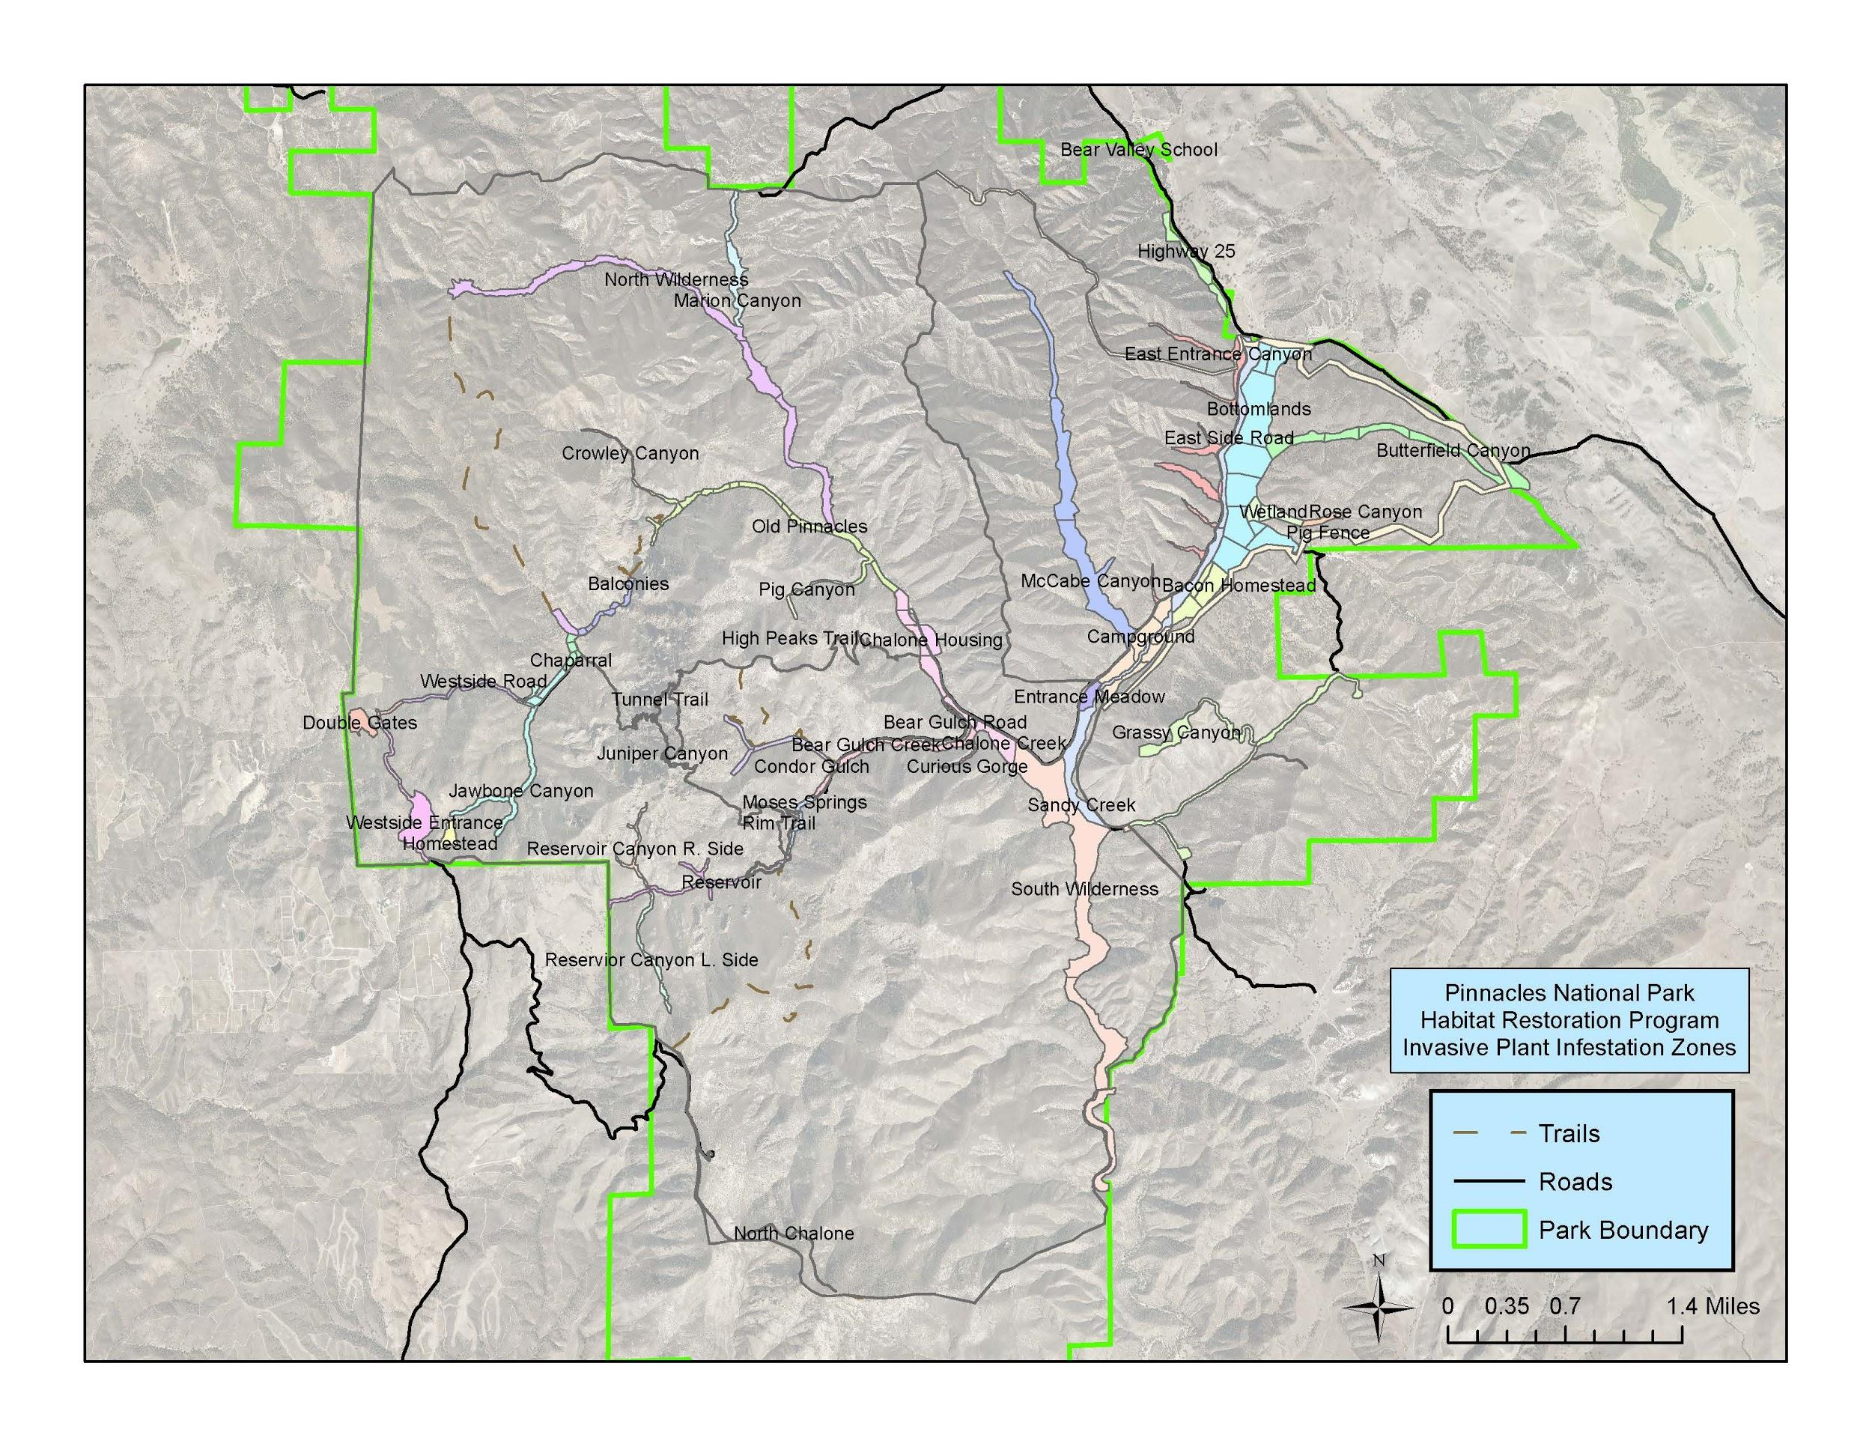
Scope
Notes:
Brent 4

Slide 15
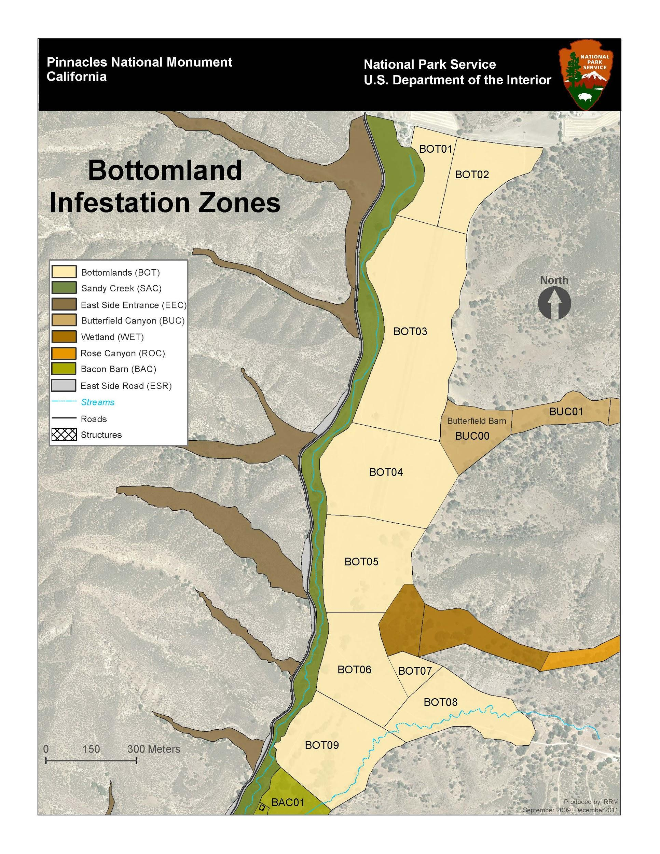
Notes:
Brent 4

Slide 16
Identify Team
• People who will develop the Plan
• People who will implement the Plan
• Key decision-makers
• Partners or other important stakeholders*
• Technical advisors
*Check with your agency/organization regarding who is permitted to be a part of a planning team
(e.g. Federal Agencies & FACA).
Notes:
Brent 5

Slide 17
Gather site-specific information
Personal Knowledge/ Expertise
Site Surveys
Management Plans/Records
Spatially Referenced Information
Invasive Plant Lists
Early Detection Plant Lists
Non-native plant rankings/legal status
Notes:
Brent 3

Slide 18
Laws and Regs. Compliance
Migratory Bird Treaty Act
Rivers and Harbors Appropriation Act
Wild and Scenic Rivers Act
Magnuson–Stevens Fishery Conservation and Management Act
CEQA
NEPA
State & Local Air Quality Regs
Coastal Zone Man. Act
Clean Water Act
NHPA
State Water Quality Board
Wilderness Act
NAGPRA
Rivers and Harbors Appropriation Act
Architectural Barriers, Rehabilitation, and Americans with Disabilities Acts
Endangered Species Act
Notes:
BRENT 4

Slide 19
Compliance Overview
Consider all possible compliance / permitting needs.
Start processes early. Some processes may take longer than expected.
Notes:
Brent 5

Slide 20
Guide: Figure 1, p.2 and Table 1, p.3
Notes:
ANDREA

Slide 21
Identify Priorities
Challenge: not enough resources to adequately address all invasive plant species everywhere
The distinction between damaging and innocuous species is critical for management and policy purposes, as it is impractical [and infeasible] to react to every species…., or to manage all established alien species
Rejmánek & Pitcairn 2002
Guide Section: 3.1, pp.13-22
Notes:
ANDREA

Slide 22
Why Prioritize?
Optimally allocate limited resources
Get buy-in/agreement from stakeholders
Establish repeatable/defensible process
Reflect on current management priorities
Understand data gaps to address in future iterations
Notes:
ANDREA

Slide 23
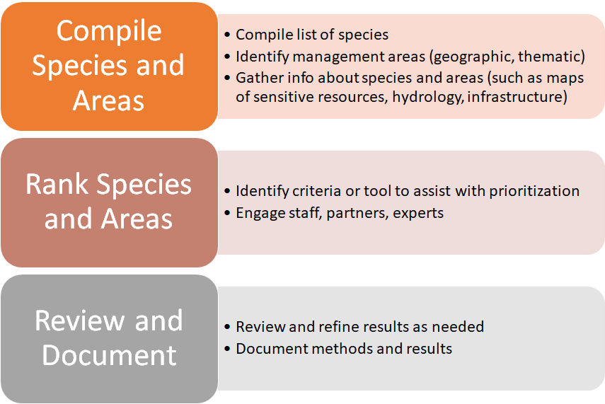
Notes:
ANDREA

Slide 24
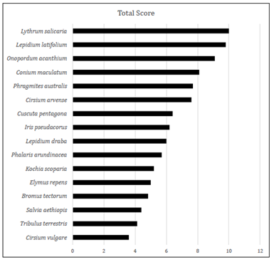
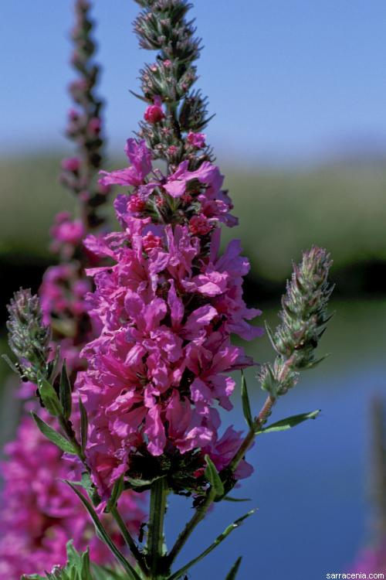
Prioritization Example
USFWS: Klamath National Wildlife Refuge Complex
Limited resources, competing priorities (natural resources vs farming)
2-day workshop: refuge staff + ag community
Mgt history review + prioritization
Invasive Plant Inventory and Early Detection Prioritization tool
Result: consensus>increased collaboration, shift in mgt focus, extant + ED targets, lead to 1st ever baseline inventory
Notes:
ANDREA
Species currently managed - many still in top 10 but a few were bumped down quite a bit (for example, kochia was a big focus but all agreed its not a top priority). Some areas that have been a focus out of habit will no longer be a focus - a realignment of available resources. One of the biggest wins was getting everyone around the table to agree on priorities - all working together on similar priorities>increased likelihood of making real progress. Concensus was a huge accomplishment - first time all involved in invasive plant mgt (farmers/ag+refuge) came together and

Slide 25
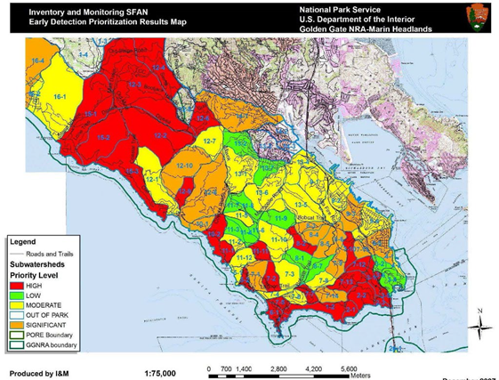
Prioritization Example
NPS: San Francisco Bay Area Network
Rare species and habitats
Number of invasive guilds present
Risk of invasion (infrastructure and veg type)
Prior management effort
Result: guides early detection and inventory efforts
Area prioritization; species prioritization done separately
Notes:
ANDREA
Need to add the why - what was the impetus for needing prioritization? ED protocol?

Slide 26
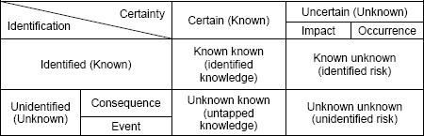
Data Gaps
What do you know?
What do you think you know?
What do you not know?
How can you address these gaps?
Kim, S. D. (2012). Characterizing unknown unknowns. Paper presented at PMI® Global Congress 2012—North America, Vancouver, British Columbia, Canada. Newtown Square, PA: Project Management Institute.
Notes:
ANDREA
Direct group to think about their land. Ask what they might need to know.
Do they know where the weeds are? What weeds are present? Rare or priority assets?

Slide 27
Guide: Figure 1, p.2 and Table 1, p.3
Notes:
ANDREA

Slide 28
Describing the Invasive Plant Problem:
Inventory and Early Detection Surveys
“An inventory serves to diagnose the weed problems within a landscape, and not until the diagnosis is complete can comprehensive and complete management actions be taken. In a sense, weed inventories [or early detection] are as critical to land health as medical exams are to human health, and a tangible weed map is just as vital to a land manager as an x-ray would be to a medical professional.”
Andersen and Dewey (2007)
Guide Section: 3.2, pp.22-27
Notes:
ANDREA

Slide 29
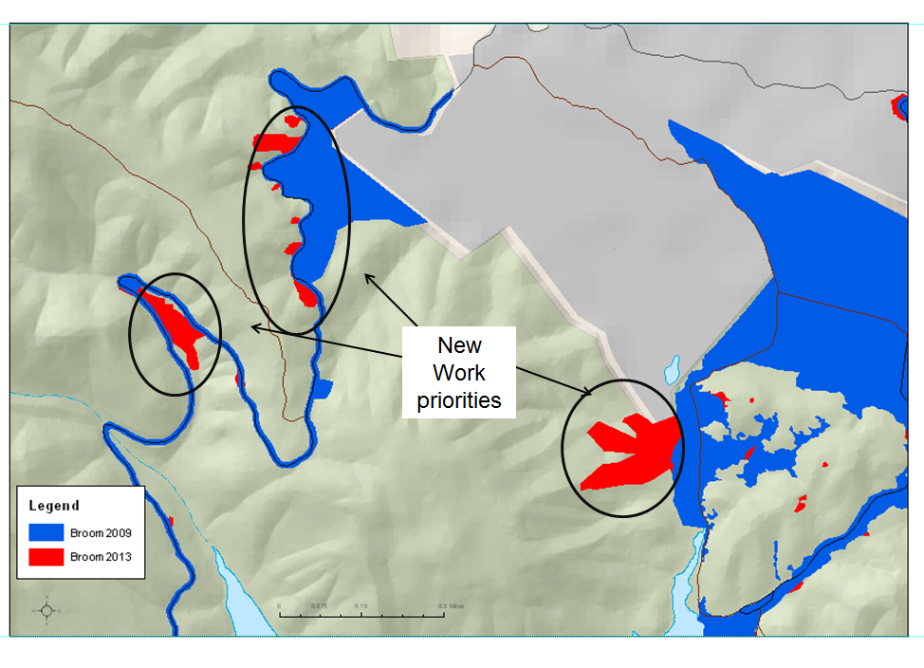
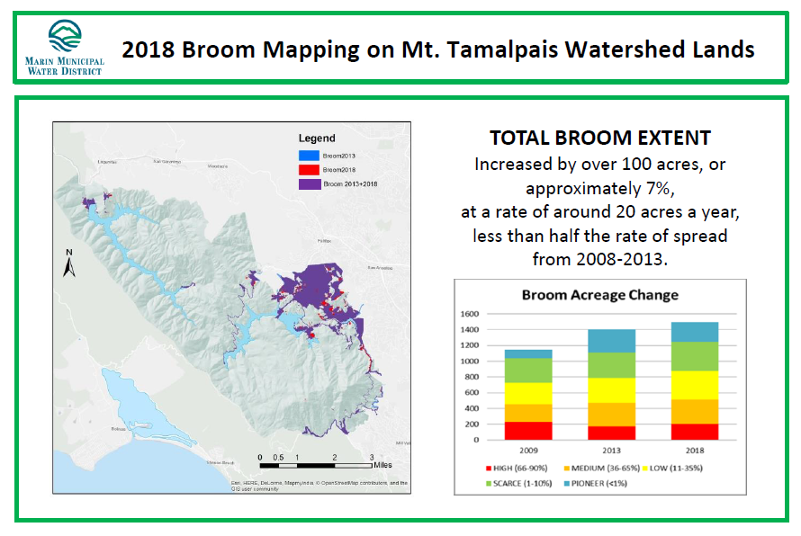
Describing the Invasive Plant Problem:
Inventory and Early Detection Surveys
Is it worth it? YES!!!
Understand patterns of spread
Inform management strategies
Guide on-the-ground management
Increase support
Essential for SMART objectives
In order to ask “Where are we now?” we must know “Where did we start?”
Notes:
ANDREA

Slide 30
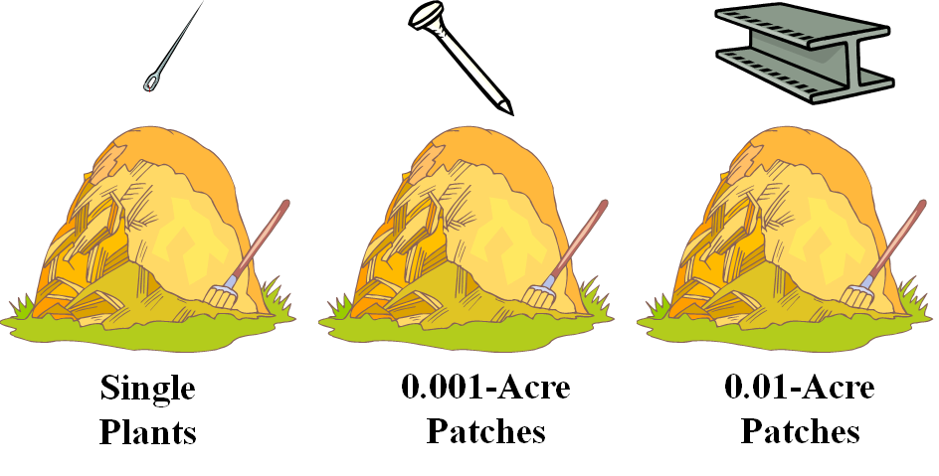
Methods:
Inventory & Early Detection
Common considerations
Survey objectives
Safety
Budget
Spatial scale and frequency
Expertise and training
Access and timing (terrestrial/
aquatic, topography, phenology)
Species characteristics (rarity, size, phenology, +)
Disturbance (sensitive species, weed spread/trail creation)
https://www.nps.gov/im/sfan/invasive-plants.htm
Notes:
ANDREA
No one-size fits all method
Great resource: ED protocols in NPS

Slide 31

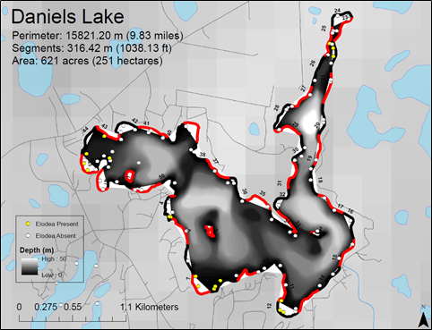
Early detection surveys (eDNA) for Elodea, Kenai Peninsula, AK.
Utility: rapid response/eradication, prevent spread, modeling future spread, increasing support
Notes:
ANDREA
Elodea is not native to Alaska, and it is the first invasive freshwater aquatic plant known here. It has the potential to impact freshwater resources and fish habitat statewide.

Slide 32
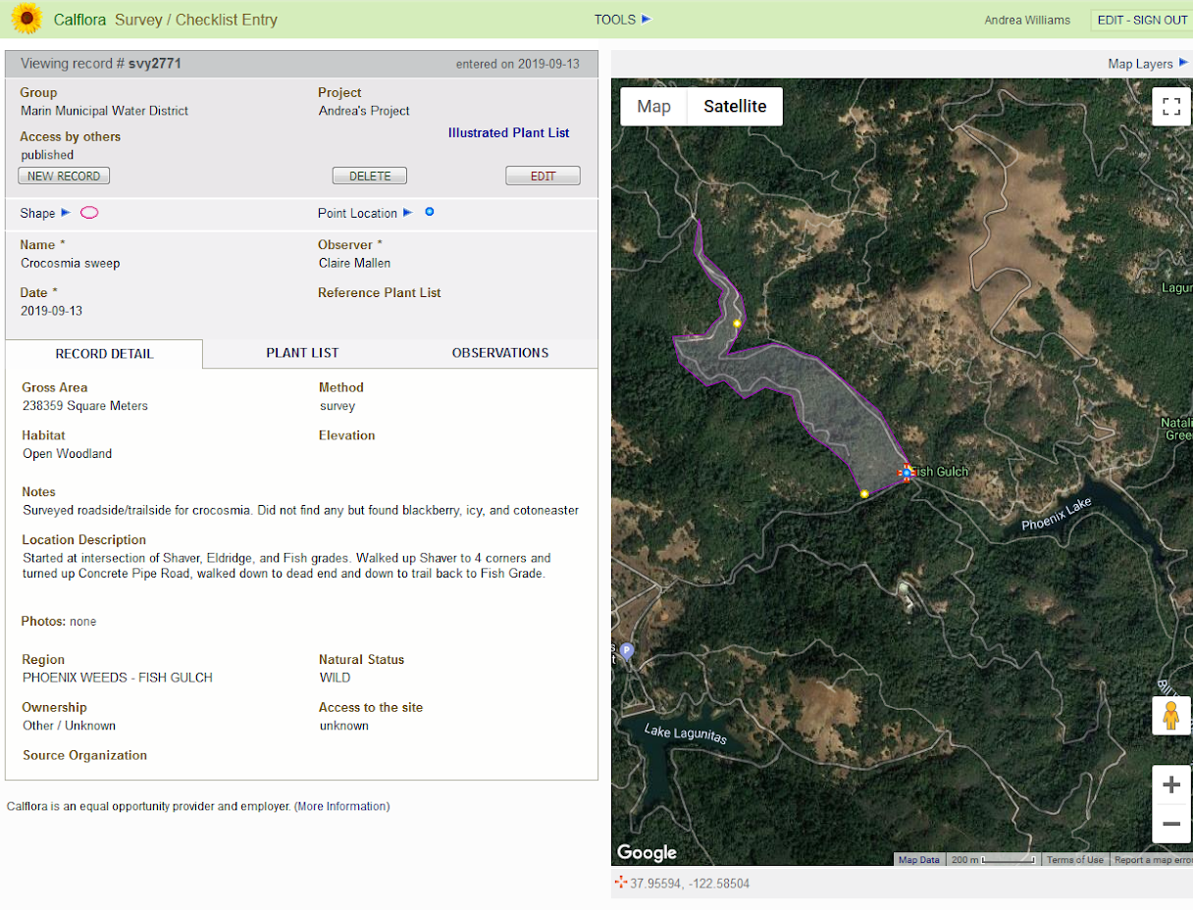
Describing the Invasive Plant Problem
Early detection at Marin Municipal Water District:
Found 9 new weed species
when populations fewer than
100 plants
Worked towards extirpation
of medusahead, cheatgrass
Mapped survey areas so we know where we’ve looked and for what
Garnered additional resources based on broom spread mapping
Notes:
ANDREA

Slide 33
QUESTIONS?
Notes:
Doug/Alene MC

Slide 34
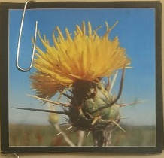
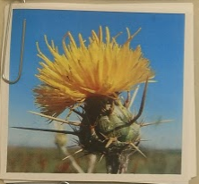

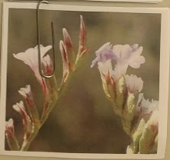

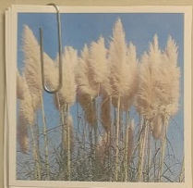
Breakout Session I
Goal: Compile the basic information necessary to begin drafting an Invasive Plant Management Plan
Dangermond Preserve, Santa Barbara County
San Diego County EDRR
Farallon Islands, San Francisco
Andrea
Doug
Tom
Jason
Steve
Giselle
Notes:
JUTTA – Instructions
Breakout into six groups based on the picture you received.
Write your names and group on question sheet
Spend 20 minutes to answer the questions that have been provided to you.

Slide 35
BREAK!

Slide 36
Breakout Session I Summary
1. Dangermond Preserve, Santa Barbara County
2. San Diego County Early Detection / Rapid Response
3.Farallon Islands, San Francisco
Notes:
jutta

Slide 37
Guide: Figure 1, p.2 and Table 1, p.3
Notes:
GISELLE

Slide 38

Management Objectives
If your invasive plant management strategies were successful, what would that look like?
SMART objectives…..
Specific
Measureable
Achievable
Results-oriented
Time-bound
Guide Section: 3.3, pp.28-29
Notes:
GISELLE

Slide 39
Management Objectives
Essential ingredient for learning and adapting
Did I achieve what I expected? If not, why not?
  Strategies implemented as planned?
  Strategies worked as expected?
What needs to change, if anything?
Notes:
GISELLE

Slide 40
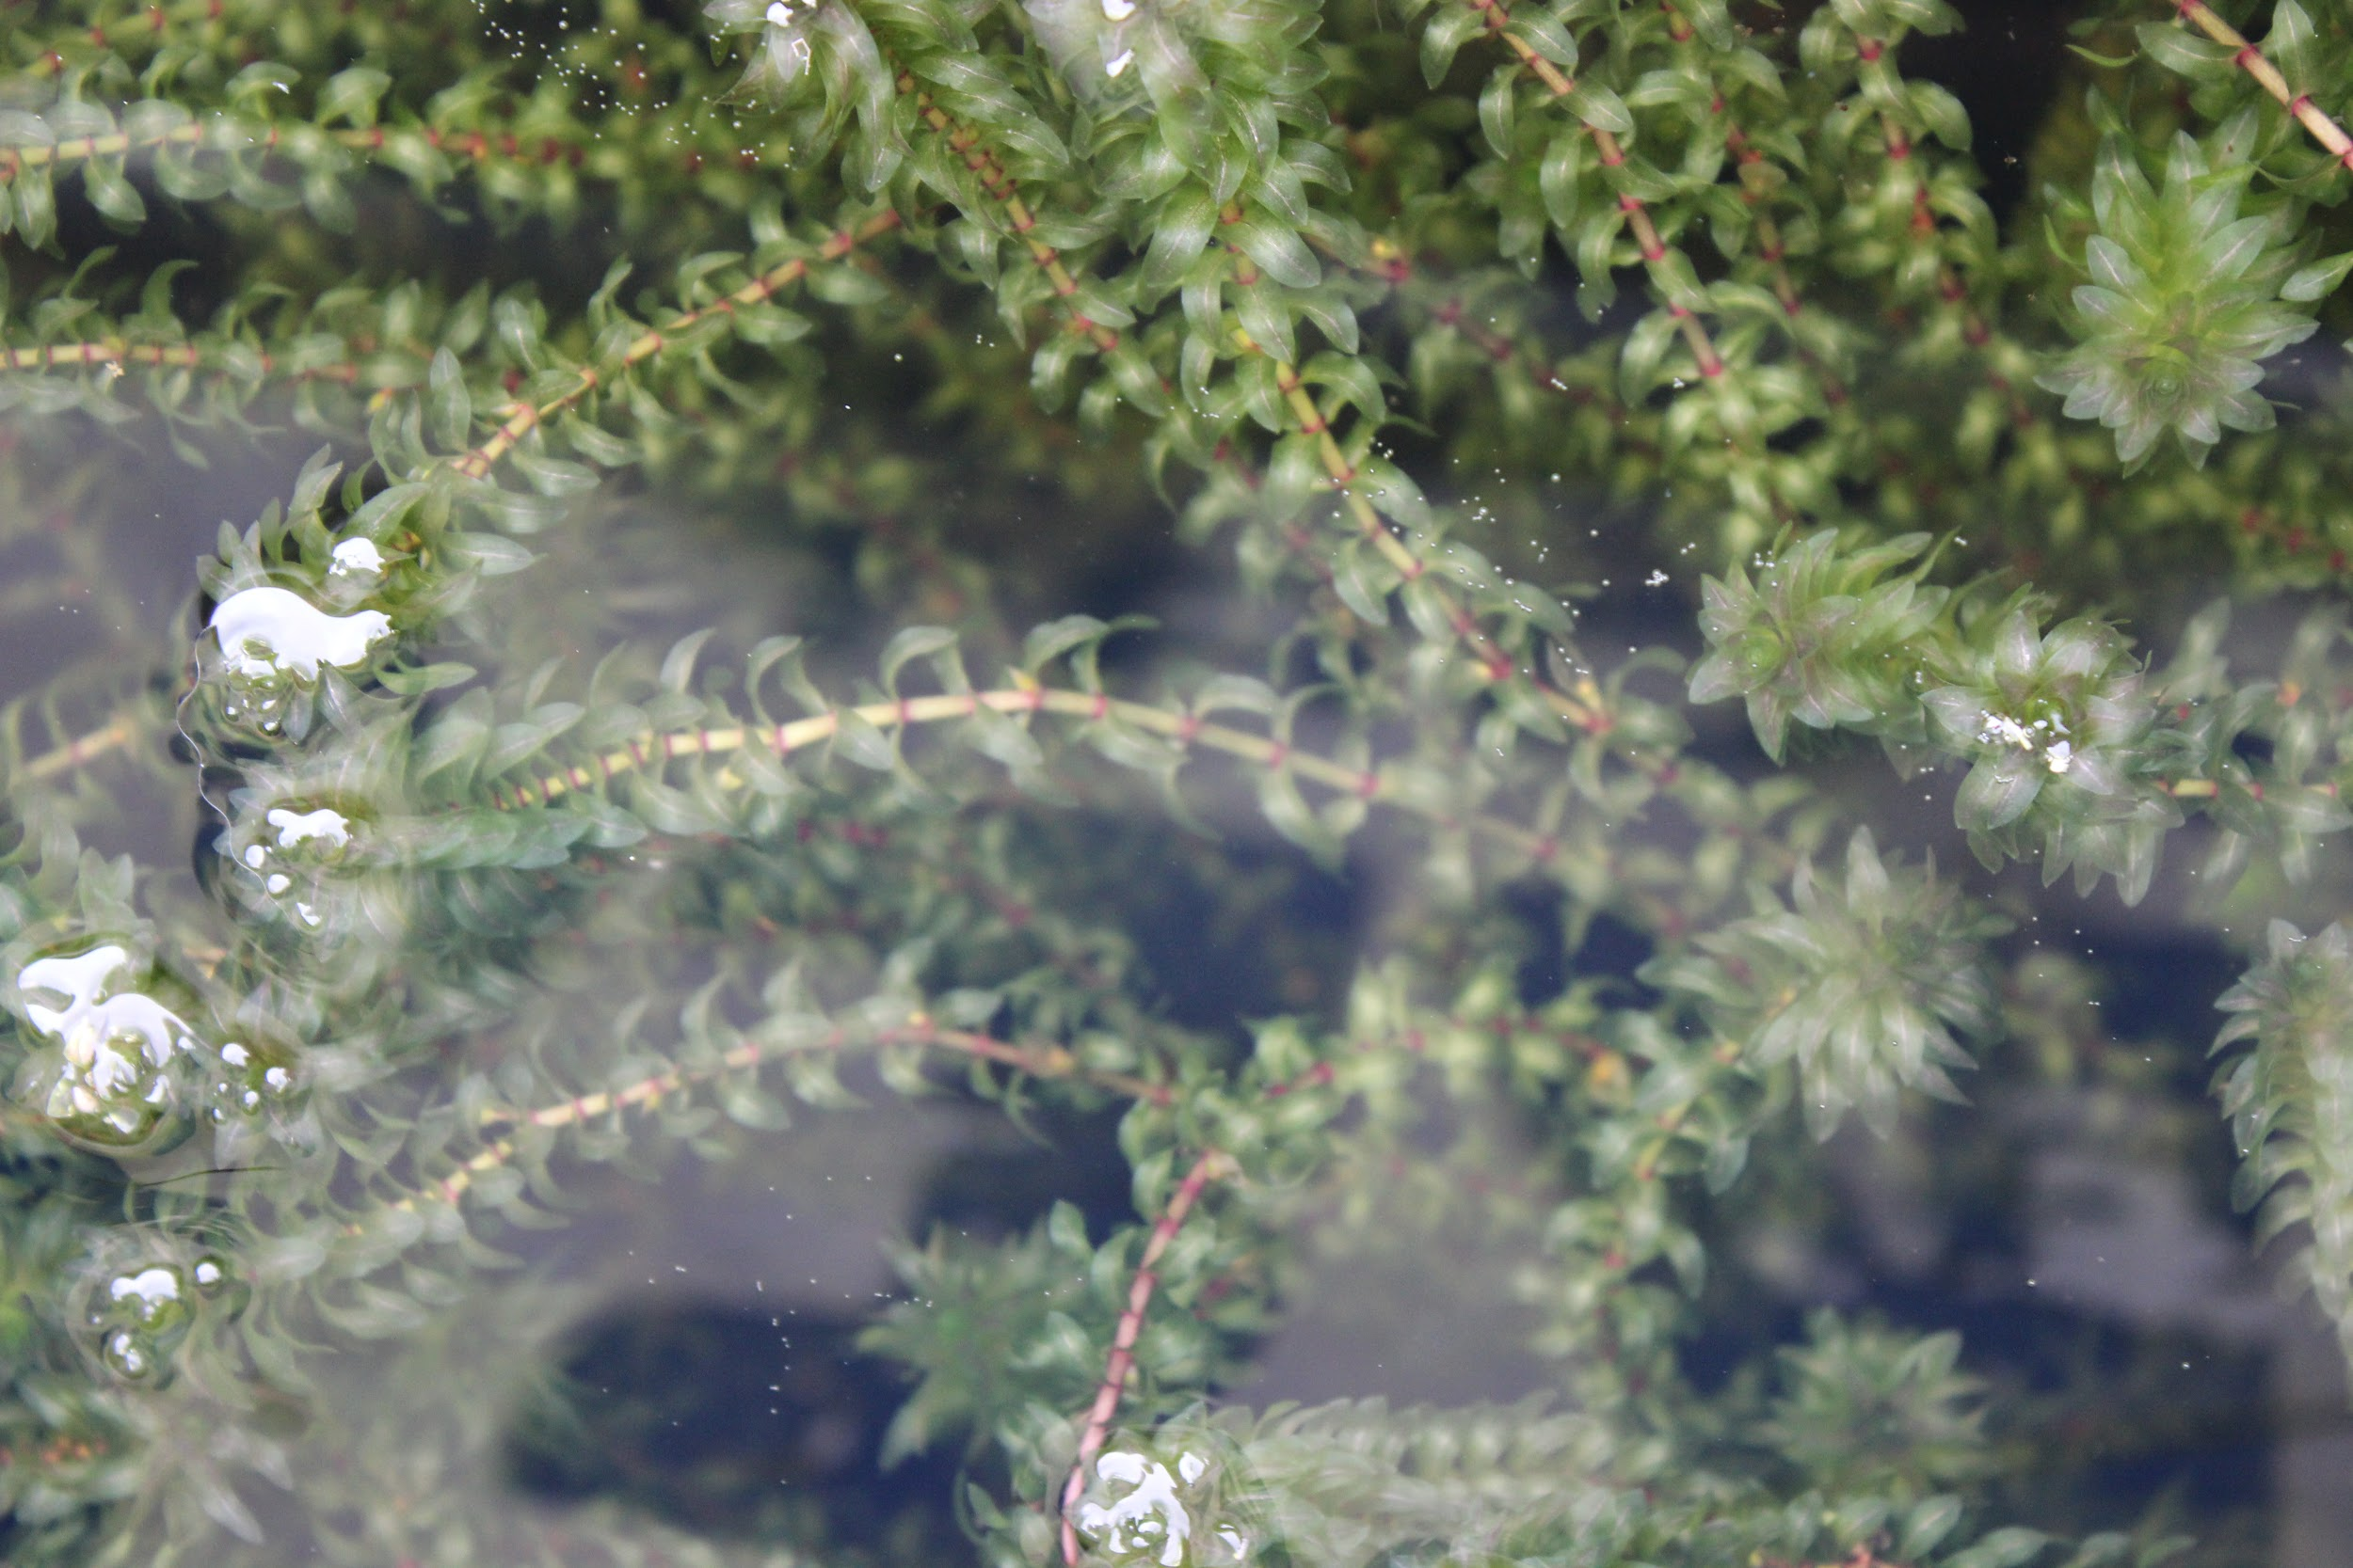
Management Objectives
Over the next 10 years (2020-2030), prevent the establishment (reproduce and spread) of Elodea species within the Arctic National Wildlife Refuge
Smart: check
Measurable: check
Achievable: check
Results-oriented: check
Time-bound: check
Notes:
GISELLE
Elodea canadensis and E. nuttallii (and hybrid, Elodea canadensis x nuttallii)

Slide 41
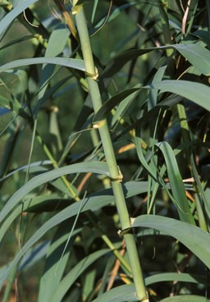
Management Objectives
Reduce the cover of Arundo donax
Specific: X
Measurable: X
Achievable: check
Results-oriented: check
Time-bound: X
Notes:
GISELLE

Slide 42
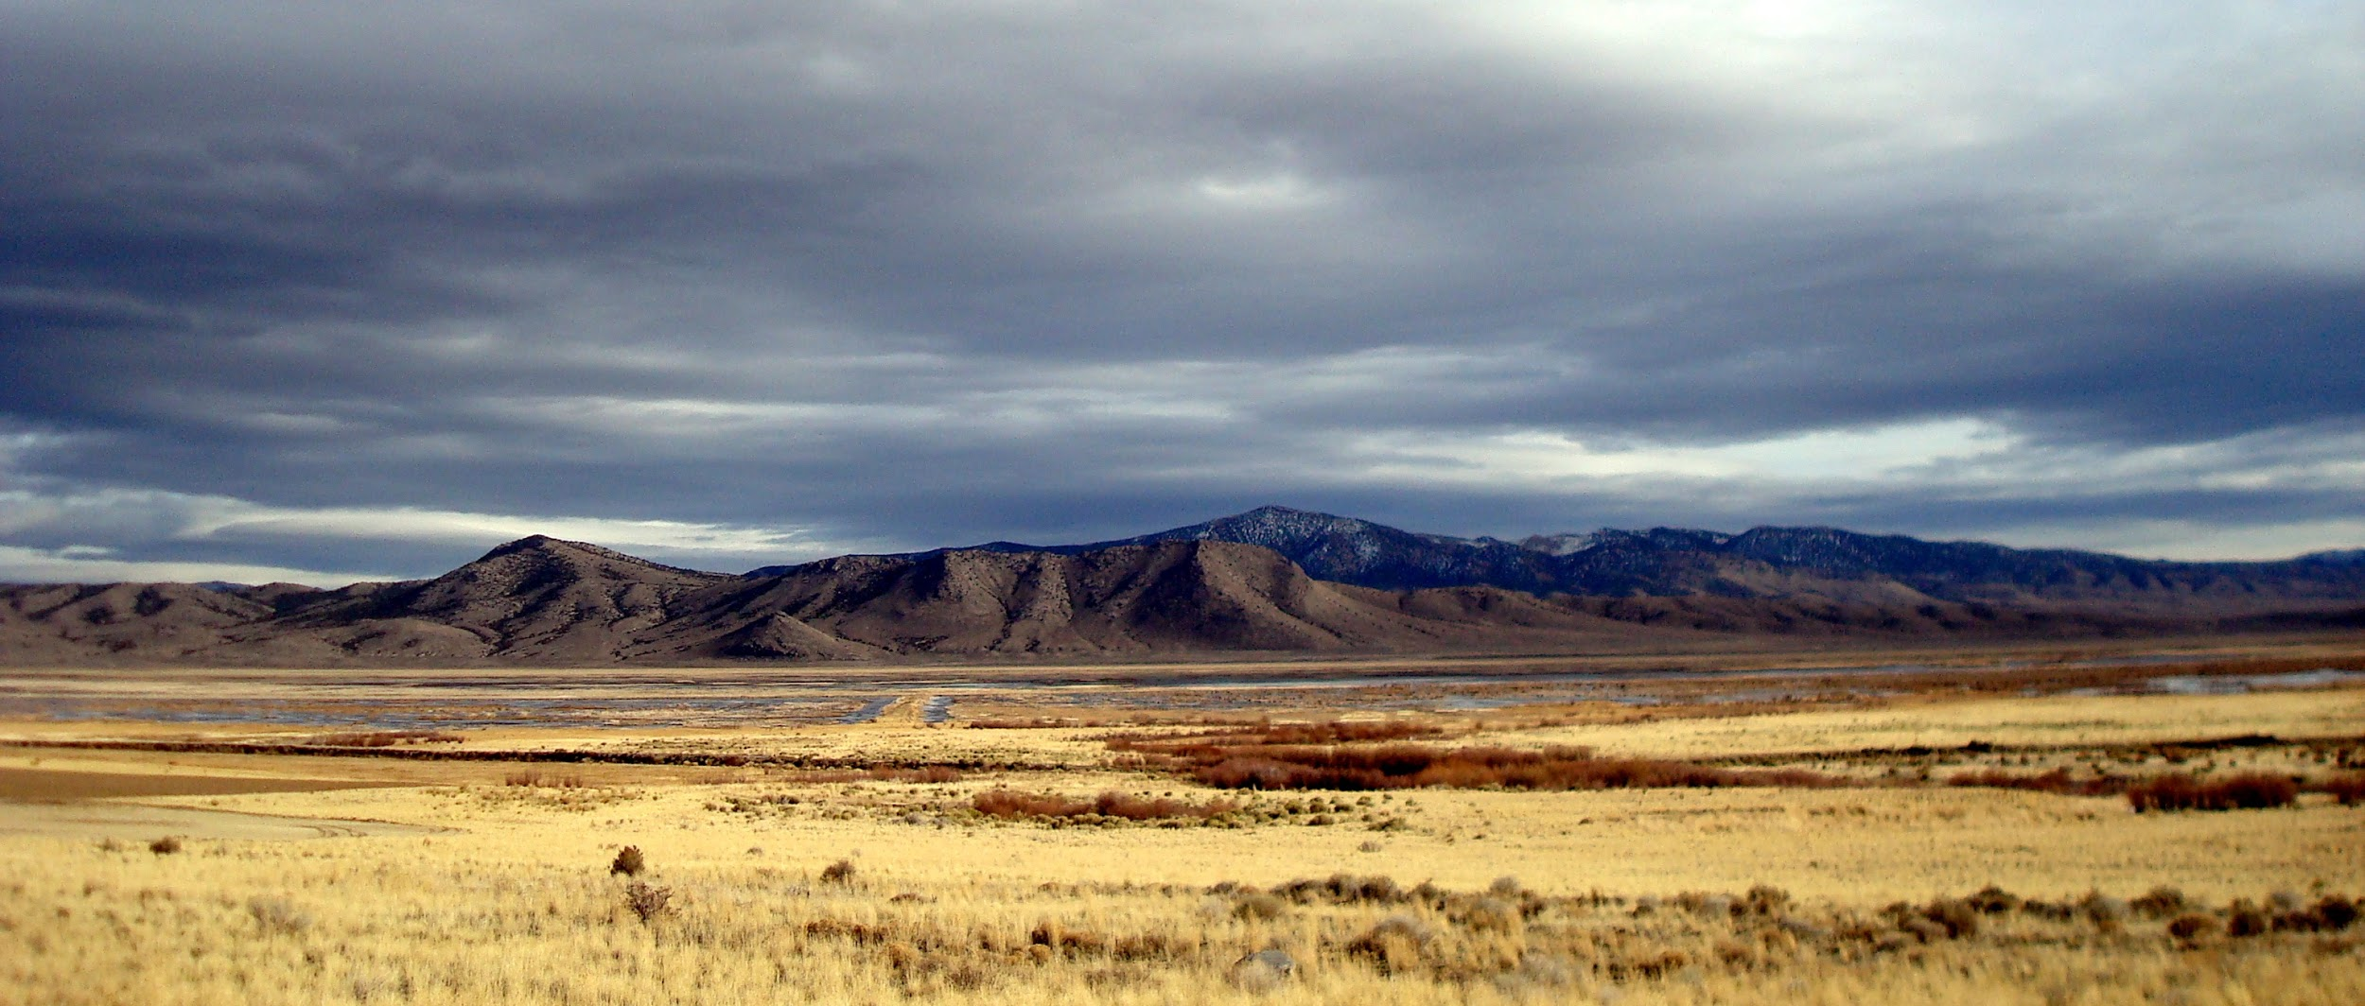
Management Objectives
Annually treat perennial pepperweed (Lepidium latifolium) populations at the Bear Valley National Recreation Area
Specific: check
Measurable: check
Achievable: check
Results-oriented: X
Time-bound: check
Notes:
GISELLE

Slide 43
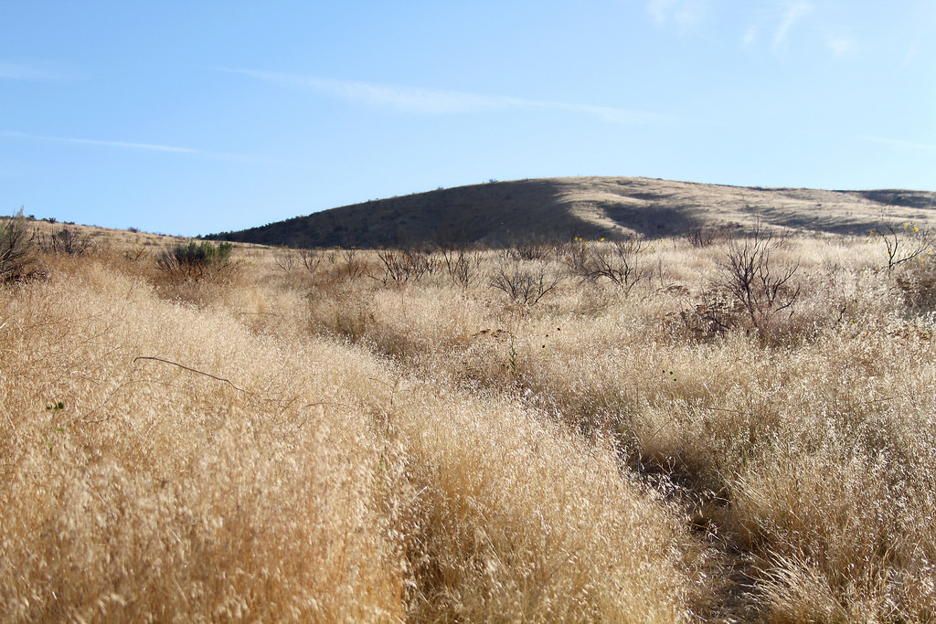
Management Objectives
Eradicate cheatgrass from the Ruby Grassland Nature Preserve by 2025
Smart: check
Measurable: check
Achievable: X
Results-oriented: check
Time-bound: check
Notes:
GISELLE

Slide 44
Guide: Figure 1, p.2 and Table 1, p.3
Notes:
TOM

Slide 45
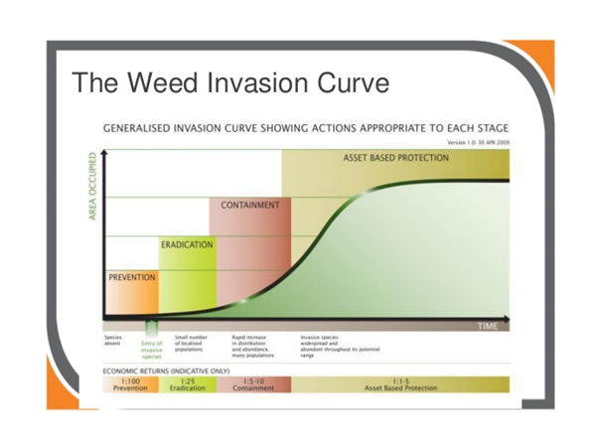
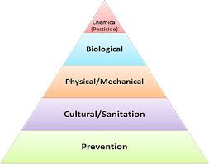
Integrated Pest Management
Selecting Optimal Strategies
Approach:
Prevention, eradication,
containment, suppression
Technique:
Integrated set of techniques
Guide Section 3.4, p.30
Notes:
TOM - Giselle added, use or delete
Note: strategies are - designed to meet SMART objectives, high Impact, feasible, safe, supported, meets legal/policy requirements

Slide 46
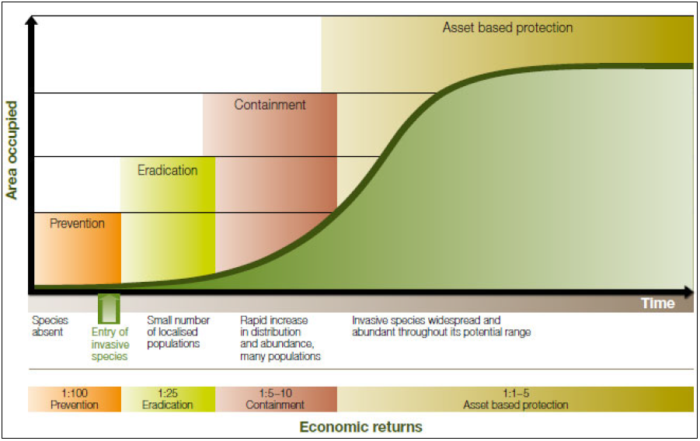
Designing a Management Strategy
Initial planning steps
  Gathering site specific information
  Prioritization
  Assessing status
  Developing SMART objectives
What approaches and techniques should be employed to achieve objectives?
Have you set yourself up for success?
Guide Section 3.4, p.30-33
Source: Agriculture Victoria 2002
Notes:
TOM
[defining your strategy]
Which populations in which areas - define management units
An invasive plant management strategy is a collection of activities or projects aimed at preventing, eradicating, containing, and/or suppressing (asset-based protection) targeted invasive plant species.

Slide 47
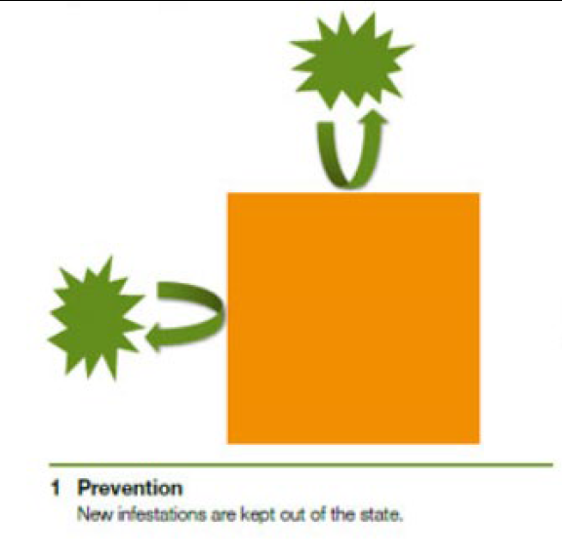
Designing a Management Strategy
Prevention
Frontline defense against invasive species
Understand vector pathways
  Natural
  Anthropogenic
Address areas vulnerable to invasion
Surveillance / EDRR is a must!
Guide Section 3.4, p.31-32
Notes:
TOM
[describe different approaches]
Extirpation, not Eradication
Mention importane of defining terms
•Prevention
•Understand the likely means of introduction and transport
•Establish a prevention (biosecurity) strategy at key vector pathways
•Eradication
•(1) having adequate resources and commitment to see the project through to completion;
•(2) having an entity with authority to implement eradication;
•(3) fully understanding the biology of the species;
•(4) having the ability to detect the target species at low densities; (EDRR)
•(5) having capacity for subsequent restoration of the system (Simberloff 2003).
•Containment
•prevent establishment or to control a plant species beyond a predefined area known as the containment unit
•plus a surrounding buffer zone that is free from plants but can receive propagules
•Repeated EDRR required within buffer zone
•Asset-Based Protection
•No hope of eradication
•Protect sensitive species and habitats

Slide 48
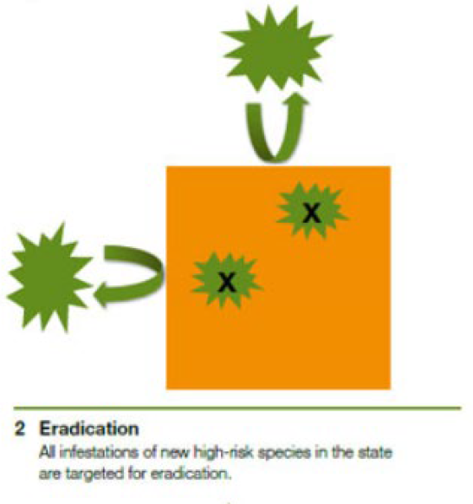
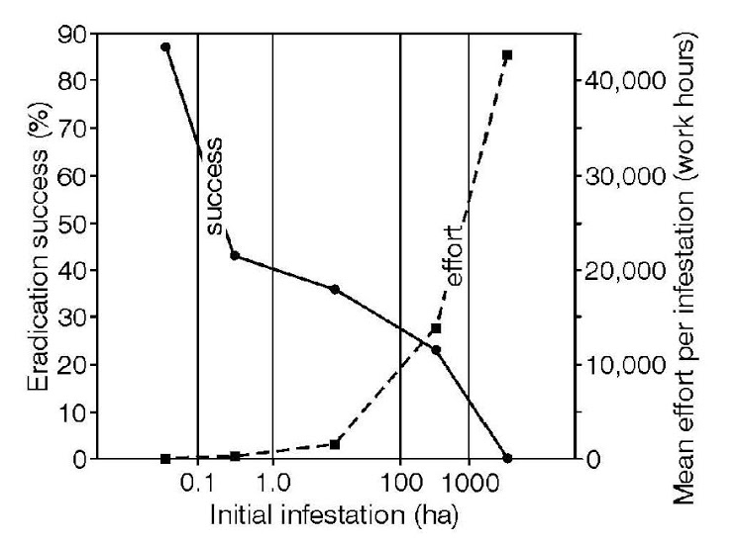
Designing a Management Strategy
Eradication
Must have adequate resources
Follow-up!
Ability to detect at low density
Surveillance / EDRR is a must!
Guide Section 3.4, p.32-33
Notes:
TOM
[describe different approaches]
Extirpation, not Eradication
Mention importane of defining terms
•Prevention
•Understand the likely means of introduction and transport
•Establish a prevention (biosecurity) strategy at key vector pathways

Slide 49
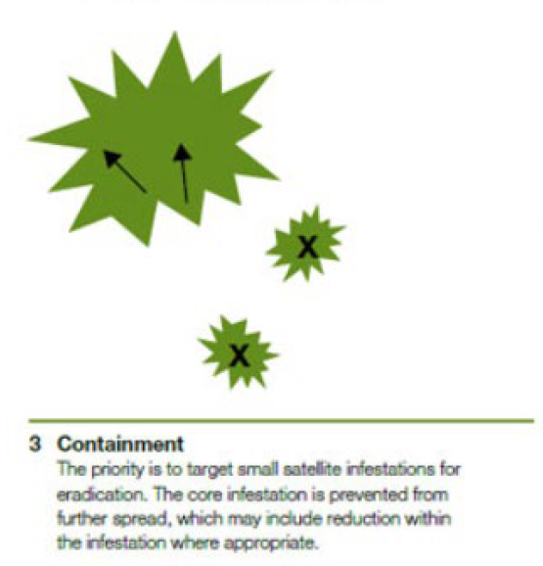
Designing a Management Strategy
Containment
Define a containment unit
Define a buffer zone free of invasive species, but may receive propagules
Surveillance / EDRR within buffer zone!
Guide Section 3.4, p.33
Notes:
TOM
[describe different approaches]
Extirpation, not Eradication
Mention importance of defining terms
•Containment
•prevent establishment or to control a plant species beyond a predefined area known as the containment unit
•plus a surrounding buffer zone that is free from plants but can receive propagules
•Repeated EDRR required within buffer zone

Slide 50
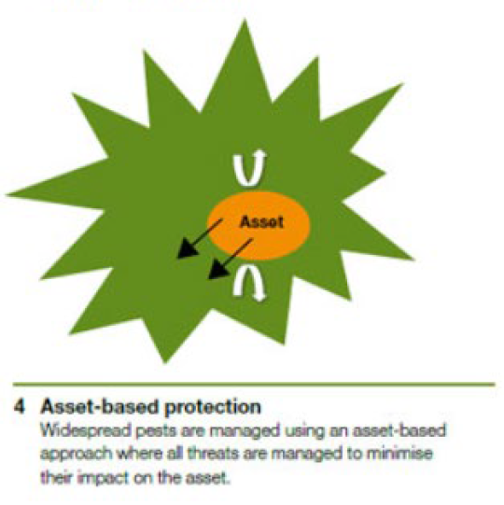
Designing a Management Strategy
Asset-Based Protection
Little hope of eradication
Protect sensitive habitats and resources
Control / suppression of invasive species
What are your SMART objectives?
Guide Section 3.4, p.33
Notes:
TOM
[describe different approaches]
Extirpation, not Eradication
Mention importane of defining terms
•Asset-Based Protection
•No hope of eradication
•Protect sensitive species and habitats
really important to understand what your objectives are so you dont spend your entire budget on something that is not effective

Slide 51
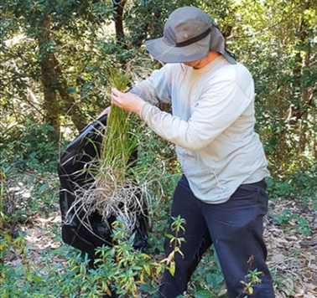
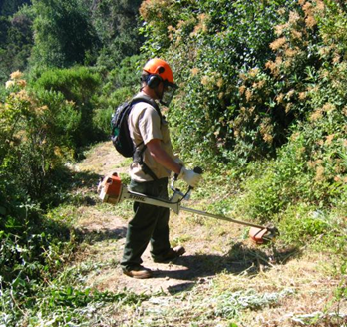
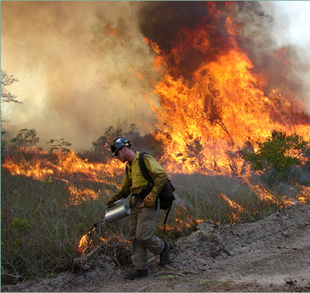
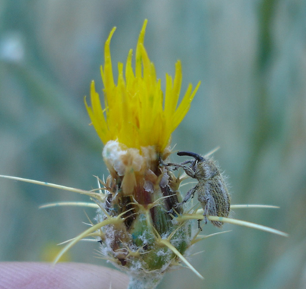
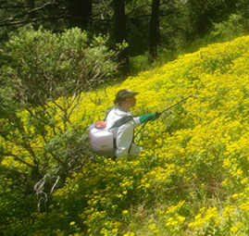
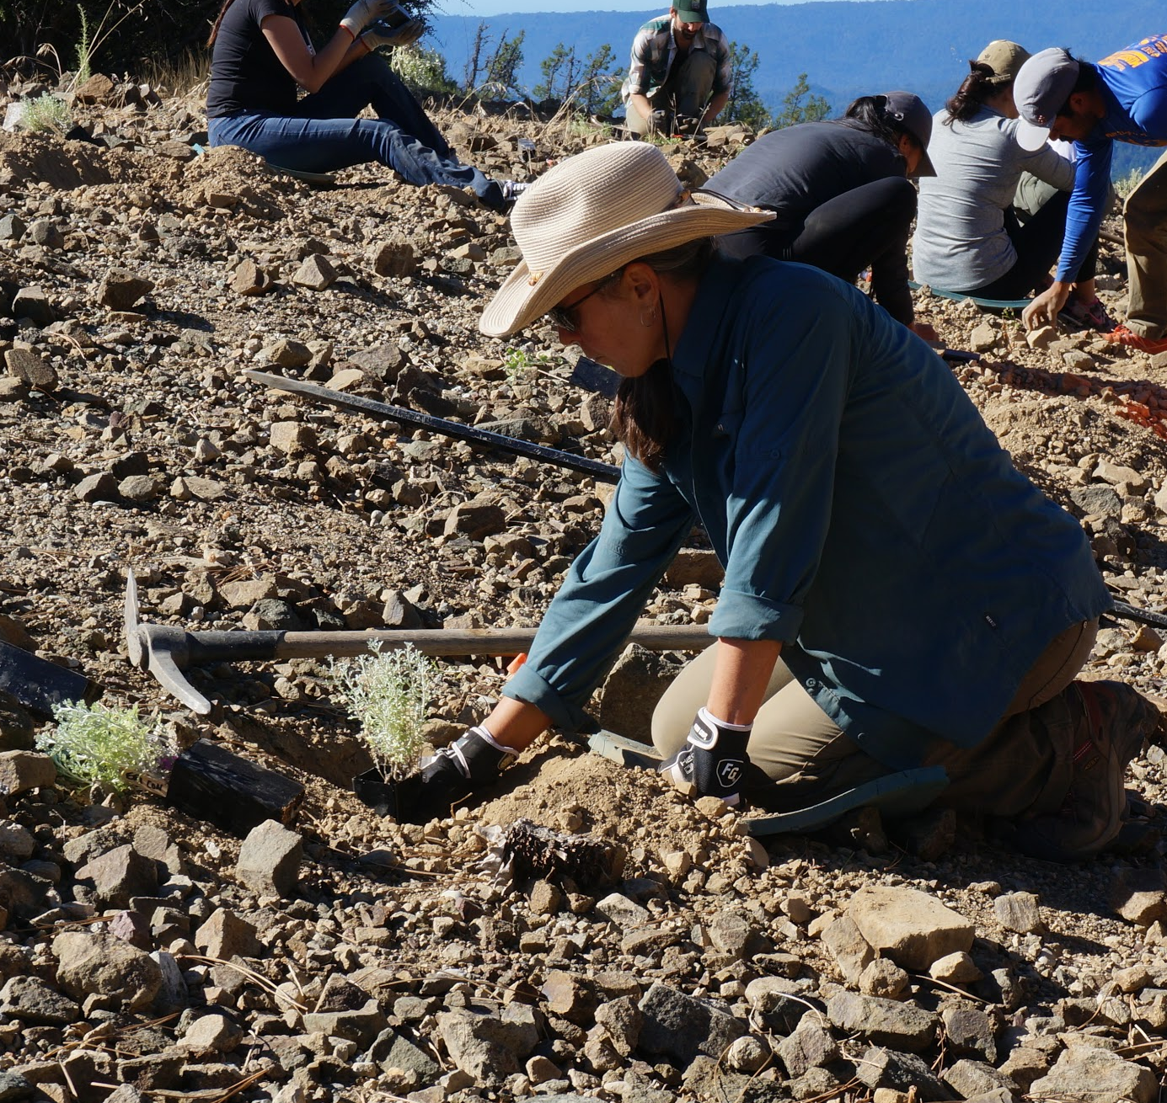
Designing a Management Strategy
Guide Section 3.4.2, p.36
Notes:
TOM
[overview of major types]
Manual
Mechanical
Cultural
Biological
Chemical
Restoration of ecosystem processes

Slide 52
Designing a Management Strategy
Factors to consider when choosing among techniques
Management objectives—what you are trying to achieve
Target species ecology, distribution, and abundance
Capacity to implement—people, cost, and technical capacity
Site characteristics such as scale, accessibility, and politics
Potential non-target effects
Likelihood of success
Guide Section 3.4.3, p.36-40
Notes:
TOM
[factors to consider when choosing among techniques]
Prevention!
Control Techniques- factors to consider
management objectives
target species ecology
capacity to implement
site characteristics
non-target effects
likelihood of success
Integrate techniques to prevent resistance

Slide 53
Designing a Management Strategy
Avoiding/mitigating non-target effects
Soil disturbance, compaction, or erosion
Water quality
Impacts to non-target plants
Direct/Indirect harm to wildlife
Direct/indirect harm to cultural resources
Further spread invasive plants
Guide Section 3.5, p.40-41
Notes:
TOM
-pull from table on page 41

Slide 54
Breakout Session II
Goal: Develop strategic goals and methods to achieve them
Dangermond Preserve, Santa Barbara County
San Diego County Early Detection / Rapid Response
Farallon Islands, San Francisco
Andrea
Doug
Tom
Jason
Steve
Giselle
Notes:
BRENT
Same case studies as Breakout I. Will include report out from each group

Slide 55
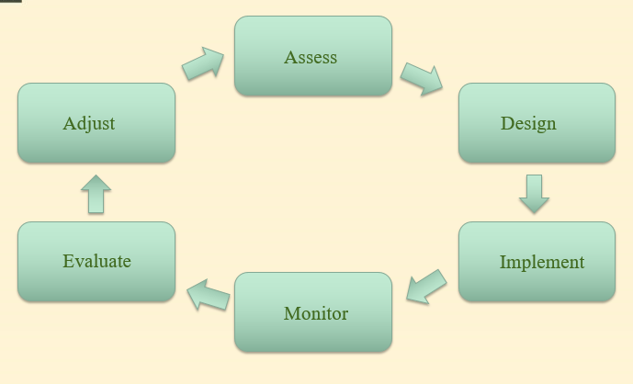
Plan Implementation and Work Planning
You’ve got a plan. Now what?
Who will do the work?
  Staff? Contractors? Volunteers?
When and where will treatment actions occur?
  Where to do what?
  Phenology
  Seasonal restrictions
  Repeat treatments
What are the costs?
  Labor
  Equipment rental
  Tools and Supplies
  Herbicide
  Permit fees
Evaluate! Revise!
Guide Section 3.5, p.40-41
Notes:
TOM
Adress potential for no allowable herbicide use - higher labor costs, etc.
The purpose of an operational plan is to provide those responsible for implementing your strategy (and associated activities) with a clear picture of what needs to get done, where, and when, as well as how much it will likely cost over a specified period of time
typically a multi-year plan

Slide 56
Plan Implementation and Work Planning
Case Study: Dangermond Preserve
Who will implement the plan?
  Volunteer is mapping weeds
  Limited, but skilled staff time available
  Contractors will implement management
When and where will they occur?
  Difficult to write a plan without comprehensive plant data
What are the costs?
  Potential for long-term funding once project begins
How to track performance?
Guide Section 3.5, p.40-41
Notes:
TOM

Slide 57
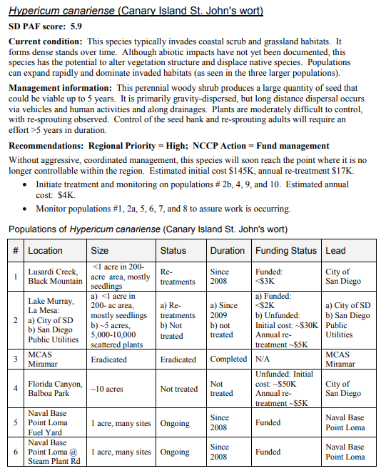
Plan Implementation and Work Planning
Case Study:
San Diego EDRR
Regional long-term management approaches for each target species
Specific techniques not described
Includes Early Detection surveillance
Funding is tracked for each treatment location
Designed to be a living document
Guide Section 3.5, p.40-41
Notes:
TOM
YOSE work plan

Slide 58
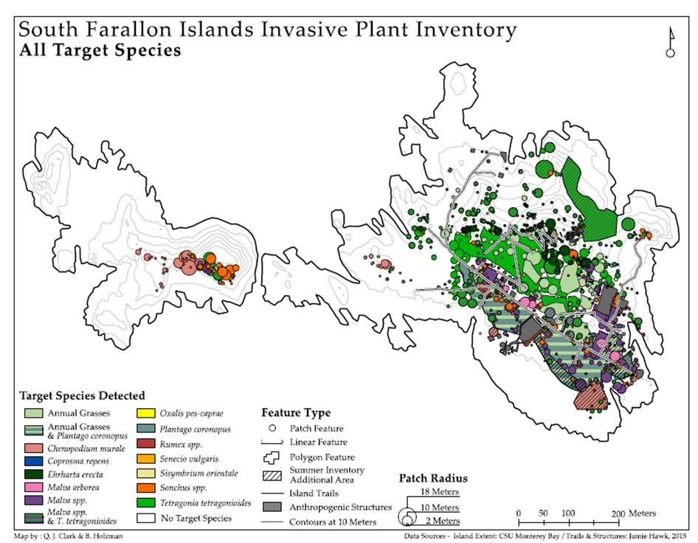
Plan Implementation and Work Planning
Case Study: Farallon Islands
What tasks are needed?
Who will implement the plan? When? Where?
What are the costs?
Performance Measures and Indicators?
Guide Section 3.5, p.40-41
Notes:
TOM

Slide 59
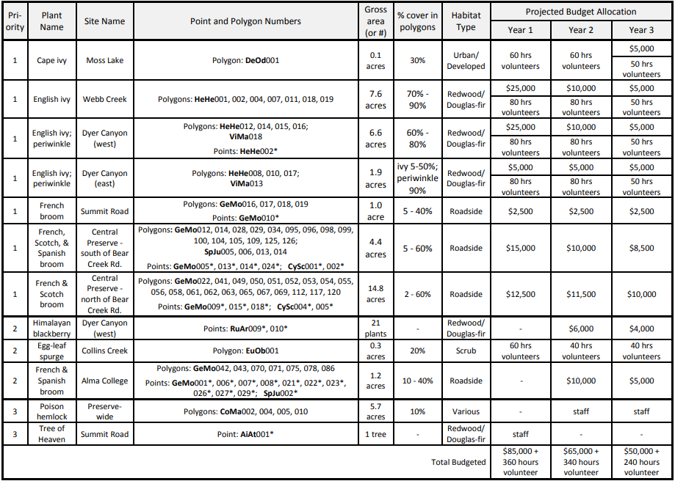
Plan Implementation and Work Planning
Bear Creek Redwoods Open Space Preserve
Notes:
TOM

Slide 60
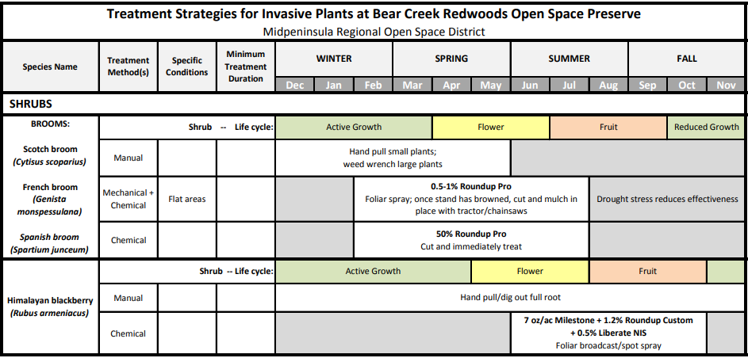
Plan Implementation and Work Planning
Bear Creek Redwoods Open Space Preserve
Notes:
TOM

Slide 61
Guide: Figure 1, p.2 and Table 1, p.3
Notes:
GISELLE

Slide 62
Monitor, Evaluate, Adapt
Are we implementing strategies as planned?
Are we achieving what we said we would?
Are we still focused on the right things in the right places?
Should we do anything differently?
Notes:
GISELLE 1
challenges and how to Implementation
Outcomes relative to objectives
Priorities - are we still focusing on the right things in the right places?
Objectives - are they still achievable?
Explore new science, tools, techniques

Slide 63
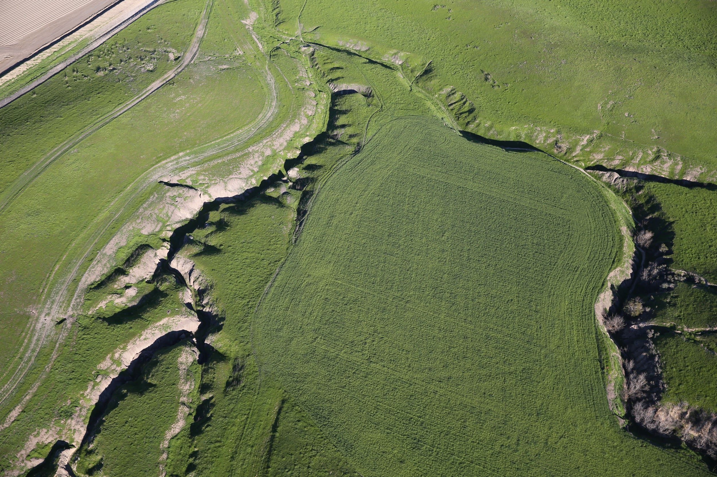
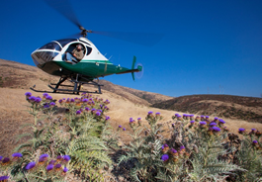

Monitor, Evaluate, Adapt
Track Implementation: what, where, when, by whom
Monitor Results relative to SMART objectives

Slide 64


Monitor, Evaluate, Adapt
Did we implement the strategies as planned?
Invasive plant(s) prevented, contained, or suppressed?
Status and trends in things we are trying to conserve

Slide 65
Humboldt Bay
Coastal Sand Dune Ecosystem
Significant decline in funding - impaired implementation
Shifts in public opinion about herbicide use
SO…..
Added burning & herbicides to suite of techniques
Previously only physical/manual techniques
Notes:
GISELLE Slide 2
Implementation issue: significant declines in funding

Slide 66

San Francisco Estuary
Invasive Spartina Project
Results: higher level of non-targets effects than originally assumed
SO……...
Temporarily cease treatment in sensitive areas
Excelerate native plant restoration
Phase in treatment and restoration in remaining infested areas
Notes:
GISELLE Slide 2
Assumptions about degree of non-target effects were wrong

Slide 67
Monitor, Evaluate and Adapt!
Identify, understand, and embrace failure!
Not-so-good assumptions
Implementation issues
Combination of the two
Failures help us learn and adapt BUT we need to detect them first
Our strategies and work plans are imperfect!
Notes:
GISELLE 1

Slide 68

Monitor, Evaluate and Adapt!
Important to make time
Build these activities into your work plan
Notes:
GISELLE 1

Slide 69
QUESTIONS?
Notes:
Doug/Alene MC

Slide 70
Wrap-up and Evaluation
You will receive an evaluation of this training within two weeks.
PLEASE TAKE IT!
Notes:
[note throughout - make sure your plan is flexible and nimble. Also incorporating IPM.]

Slide 71

Thank You!

